Slide 1


Slide 2

Introduction to TensorFlow and TensorFlow Lite

Slide 3



About me
I am Ejiro Onose
-Android developer
-I want to be a Machine Learning Engineer and a GDE when I grow up.
-
Joggyjagz7

Slide 4

….

Slide 5
But first….

Slide 6
Lets do a quick overview on Machine Learning.

Slide 7
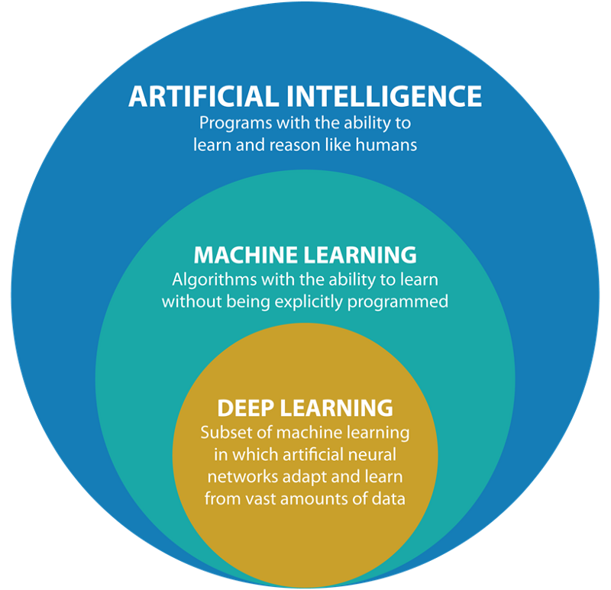

Slide 8


So in a nutshell
Machine Learning
Deep Learning
ML - subset of AI
Machines learn to do task without being explicitly programmed to do so.
Reinforcement learning, decision tree,DL,clustering…..
DL - subset of ML
DL learns to do task without explicitly programmed to do so.
Mimics the neurons in a human brain.
CNN, RNN, AutoEncoder…..

Slide 9
The Tensor in TensorFlow

Slide 10
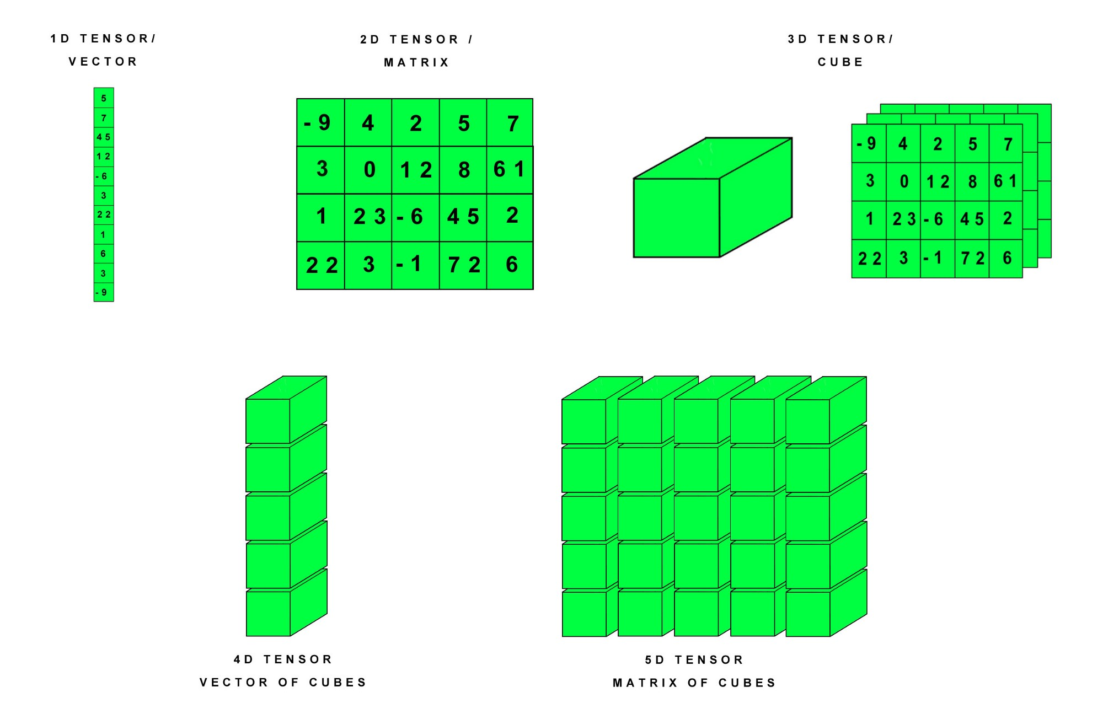
A tensor is a multidimensional array of values.
Vectors are 1-dimensional tensors, a matrix is a 2-dimensional tensor,while an array with three indices is a 3-dimensional tensor The fundamental data structure in machine learning and TensorFlow (and other machine learning frameworks) are tensors.

Slide 11
What is TF?

Slide 12
TensorFlow

Slide 13

TensorFlow is an end-to-end open source platform for machine learning with a comprehensive, flexible ecosystem of tools, libraries and community resources.

Slide 14
Why TensorFlow?

Slide 15
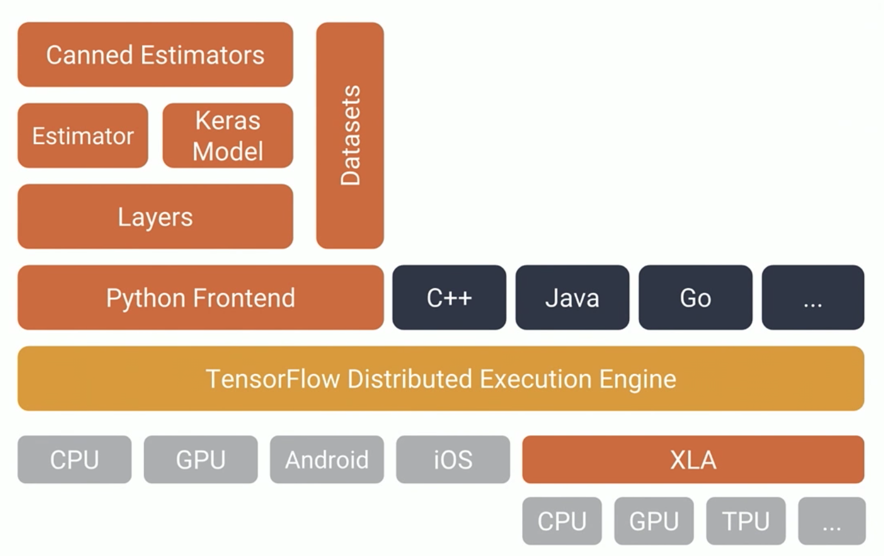
Why TensorFlow ?
TensorFlow offers multiple levels of abstraction so that you can choose the right one for your needs/use case. You can also build and train models by using the high-level Keras API, etc.

Slide 16
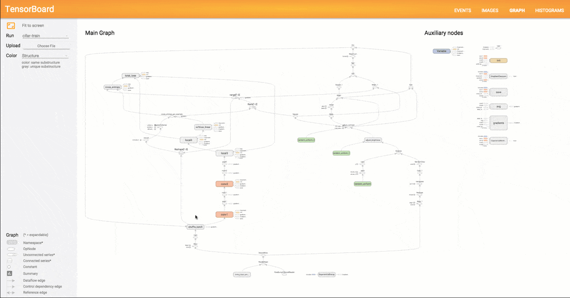
Why TensorFlow ?
2. TensorFlow offers more flexibility:
Eager execution allows for immediate iteration and intuitive debugging. For large ML training tasks, the Distribution Strategy API for distributed training on different hardware configurations without changing the model definition.

Slide 17



Why TensorFlow ?
3. There is a TensorFlow for web, mobile, edge, embedded and more
TensorFlow.js for machine learning on the web
TensorFlow Lite for mobile and embedded ML
TensorFlow Hub for reusable machine learning
TensorBoard for visual debugging
Notes:
While training a complex neural network model, the computations you use in TensorFlow can be very confusing. TensorBoard makes it very easy to understand and debug your TensorFlow programs in the form of visualizations. It allows you to easily inspect and understand your TensorFlow runs and graphs.

Slide 18
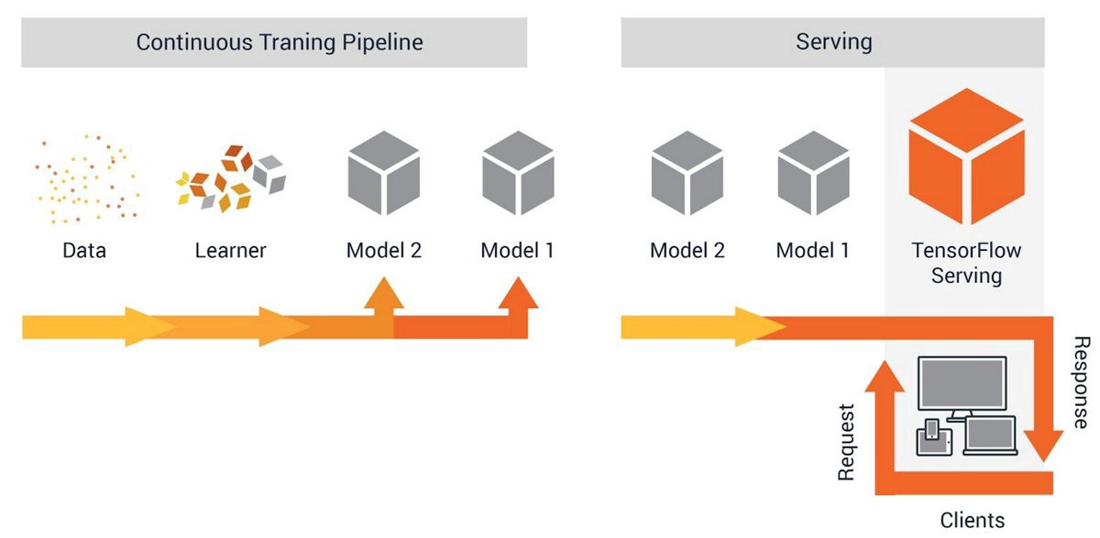
Why TensorFlow ?
4. From research to production in hours: TensorFlow Extended and TensorFlow serving makes it easy to ship models to production.

Slide 19
Why TensorFlow ?
5. Performance and Speed: With the TPU and GPU combo.
TensorFlow is the best machine learning and deep learning framework on the planet.

Slide 20
You don’t believe ?
Argue with these stats….

Slide 21
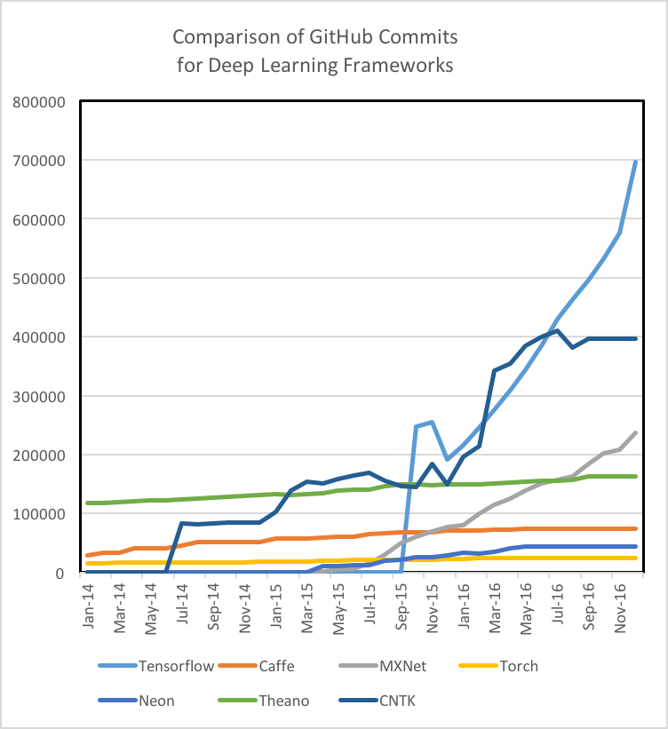
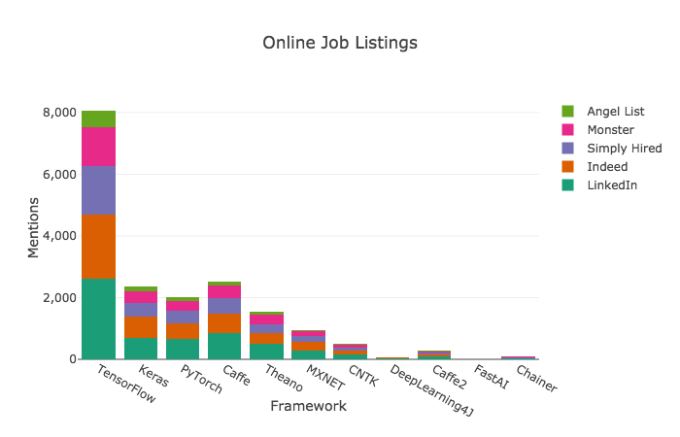
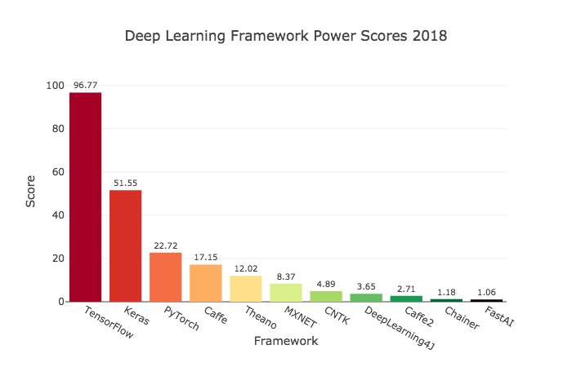
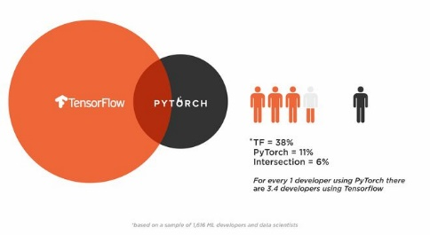

Slide 22
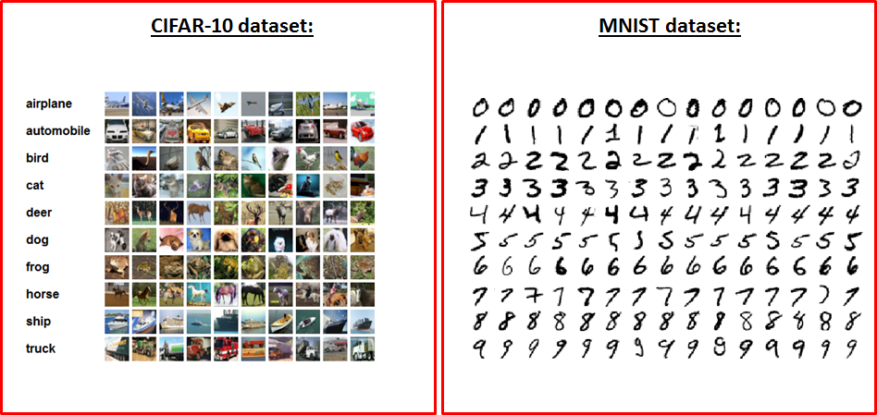
Why TensorFlow ?
6. TensorFlow has Inbuilt datasets:
MNIST dataset
CIFAR 10
Iris dataset

Slide 23
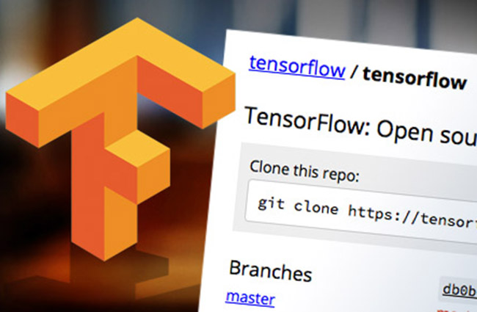
Why TensorFlow ?
7. It is Open source

Slide 24
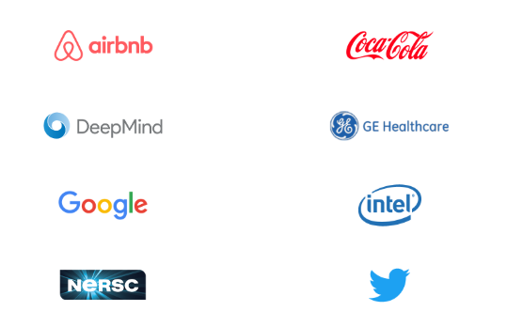
Companies that use TensorFlow

Slide 25
What is TensorFlow Lite?

Slide 26
TensorFlow Lite is lightweight solution that comprises of a set of tools to help developers run TensorFlow models on mobile, embedded, and IoT devices.

Slide 27

It enables on-device machine learning inference with low latency and a small binary size.

Slide 28
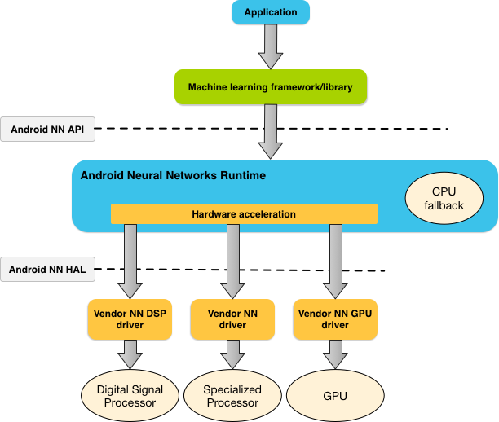
It supports hardware acceleration with the Android Neural Networks API.

Slide 29
How does it work?

Slide 30
To understand how it works, lets first know what it is made of

Slide 31
TensorFlow Lite is made up of two components:
The Converter
The Interpreter

Slide 32
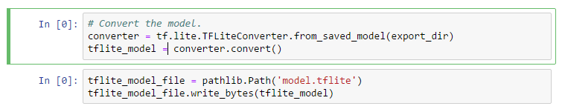
The TensorFlow Lite converter converts TensorFlow models into an efficient form for use by the interpreter, and can introduce optimizations to improve binary size and performance.

Slide 33
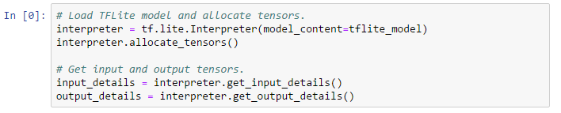
The TensorFlow Lite Interpreter is a library that takes a model file, executes the operations it defines on input data, and provides access to the output.
The interpreter works across multiple platforms and provides a simple API for running TensorFlow Lite models from Java, Swift, Objective-C, C++, and Python.
It runs specially optimized models on many different hardware types, including mobile phones, embedded Linux devices, and microcontrollers

Slide 35
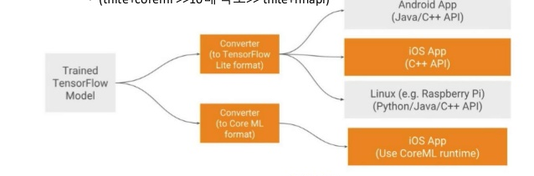

Slide 36
Why TensorFlow Lite?

Slide 37
Why TensorFlow Lite?
Low Latency:
There's no round-trip to a server

Slide 38
Why TensorFlow Lite?
1. Low Latency
2. Privacy:
No data needs to leave the device

Slide 39
Why TensorFlow Lite?
1. Low Latency
2. Privacy
3.Connectivity:
An Internet connection isn't required

Slide 40
Why TensorFlow Lite?
1. Low Latency
2. Privacy
3. Connectivity
4. Power consumption: network connections are power hungry

Slide 41
Why TensorFlow Lite?
1. Low Latency
2. Privacy
3. Connectivity
4. Power consumption
5. Quantization:

Slide 42
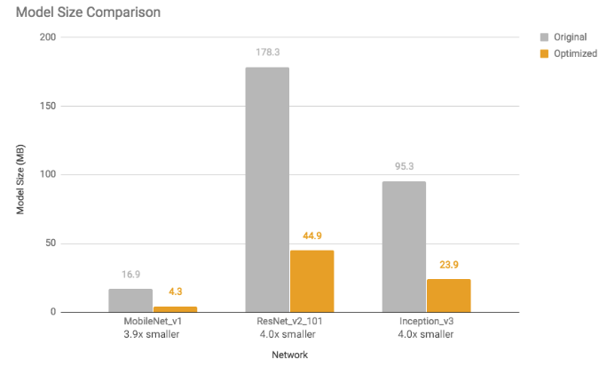
Post-training quantization is a conversion technique that can reduce model size while also improving CPU and hardware accelerator latency, with little degradation in model accuracy. You can perform these techniques using an already-trained float TensorFlow model when you convert it to TensorFlow Lite format.

Slide 43
Benefits of post-training quantization
4x reduction in model sizes
Models, which consist primarily of convolutional layers, get 10–50% faster execution
RNN-based models get up to 3x speed-up
Due to reduced memory and computation requirements, we expect that most models will also have lower power consumption

Slide 44
Why TensorFlow Lite?
1. Low Latency
2. Privacy
3. Connectivity
4. Power consumption
5. Quantization
6. GPU Support:

Slide 45
TensorFlow Lite leverages on mobile GPUs , such as
OpenGL ES 3.1 Compute Shaders on Android devices
Metal Compute Shaders on iOS devices
GPU backend performs 2–7x faster than the floating point CPU implementation for a wide range of diverse deep neural network models.

Slide 46
Why TensorFlow Lite?
1. Low Latency
2. Privacy
3. Connectivity
4. Power consumption
5. Quantization
6. GPU Support

Slide 47


Slide 48

Lets get coding……
Let’s get coding….

